Slide 1
Data Security and Privacy
Simon Foley
Insight Centre for Data Analytics
Department of Computer Science
University College Cork

Slide 2
Shannon’s Maxim
“The enemy knows the system”
Notes:
Designing security, security by obscurity;
First thing every student of computer security learns.
Easy to get wrong; hard to get right,
transparency and MagnaCartafordata

Slide 3
Security Mechanisms
Modeling and building security mechanisms
Assurance: system upholds security property.
Security Criteria: Rainbow series, Common Criteria.
Even for simple systems its hard to get it right.
Notes:
Early focus on Mechanisms and formulating and proving properties
Emphasis on data leakage; 1980s and 1990s.
Windows NT trusted users, no network [1999].
Vista EAL4, but still expected to apply security patches.
Hard to define security, verify systems, Still can’t agree what is meant by certain security properties;
U Florida study in 2013 on Programmer blind spots study;
Vulns that malicious software target.
Useful for critical components, but does not scale

Slide 4
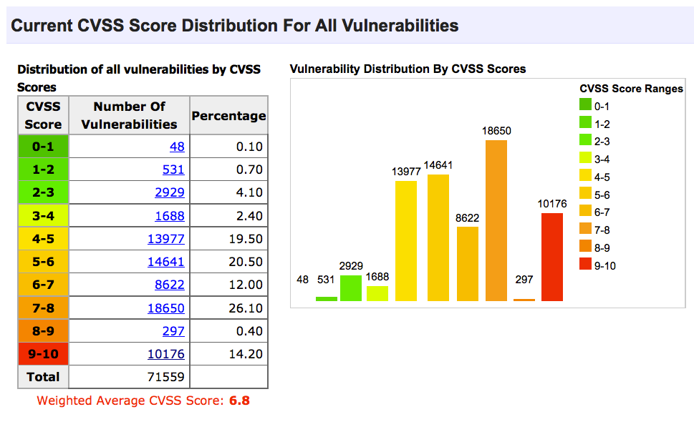
[ww.cvedetails.com]
Notes:
Recording since 1999;
2015: 4-digit yearly move to 5/6 digit yearly

Slide 5
Enterprise Security
Regard security as a risk to be managed; Identify risk, select mechanism, track efficacy;
Assurance: system follows best practices.
Security criteria: PCI-DSS, HIPPA, ..; easy to over-emphasize checkboxes.
Even for small systems its hard to get it right.
Notes:
Enterprise as a collection of systems, processes, controls, people. Large organization could have 100,000s
Assurance: specify security by comparison, rather than as an explicit property.
Failures: Data breaches,.
Organization doxing, Sony hack;

Slide 6
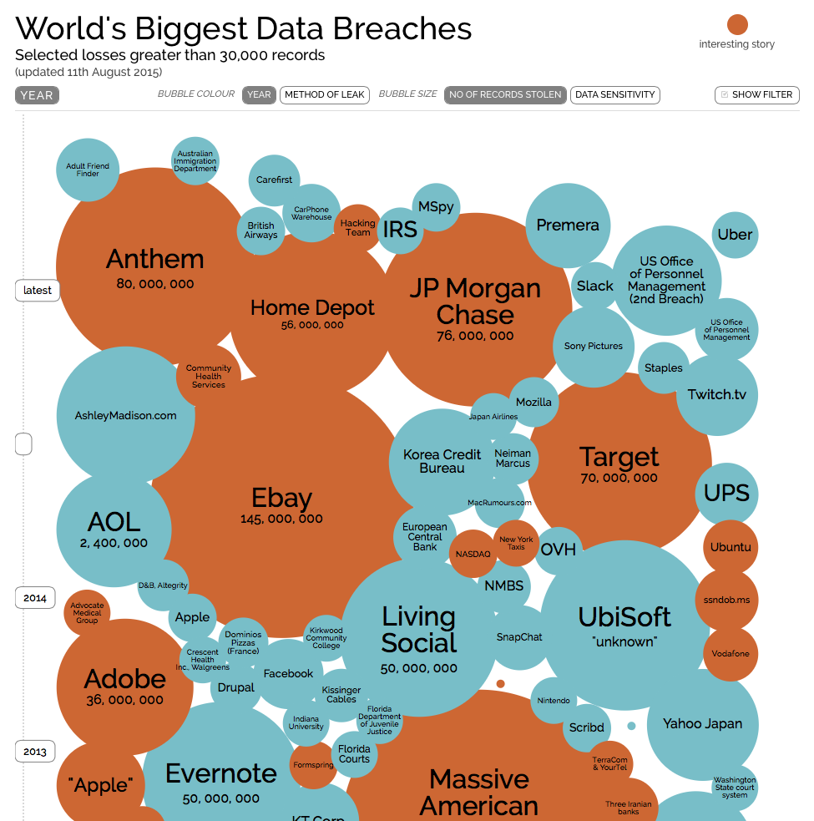
[Informationisbeautiful.net]

Slide 7
Data Privacy
Systems that store identifiable personal data.
Large centralized systems make attractive targets to outsiders and insiders.
Who collects, shares, accesses personal data?
Is AUP informed consent?
Hard to get right, even for a tech-user.
Notes:
health banking social
Outsiders: Ashley madison
Insiders: what random employees look up my data?
do you know when your employees are snooping?
data brokers who collect everything about us without even telling us?
AUP: over 10-years a social media AUP went from 1000 to 12,000 words with corresponding privacy decrease

Slide 8
Data Privacy and Anonymity
Systems store de-identified personal data.
Pseudonymization of identity is non-trivial.
Queries and linked data may reveal identity
PETs are complex and not widely adopted
Notes:
Last year NHS database of hospital episode statistics; pseudonymous patient identifier included DOB/postcode;
But at least the NHS is somewhat transparent
Pseudonymization: De-identified AOL search logs published in 2006. The searches where linked by id and it became possible to narrow down to user.
Queries: UK pseudonymous GP prescription records used for commissions on drug sales. Trackers and salesperson information.
But it will depend on queries. Rolling averages help fix the above, but are there other queries/linked data that could be used to link doctor to identity?

Slide 9
Conclusion
Getting security and privacy right is hard.
If a system knows about people then the people need to know about the system.
Reinterpret Shannon’s Maxim:
“everyone knows the system”
Notes:
Shannon’s maxim: the enemy knows the system
Cannot work on the basis of security an privacy by obscurity

