Slide 1
Ethics and Politics of Big Data
Prof. Rob Kitchin
Maynooth University
Towards a Magna Carta for Data: a workshop on the ethics of Big Data
Predict, 17th September 2015

Slide 2
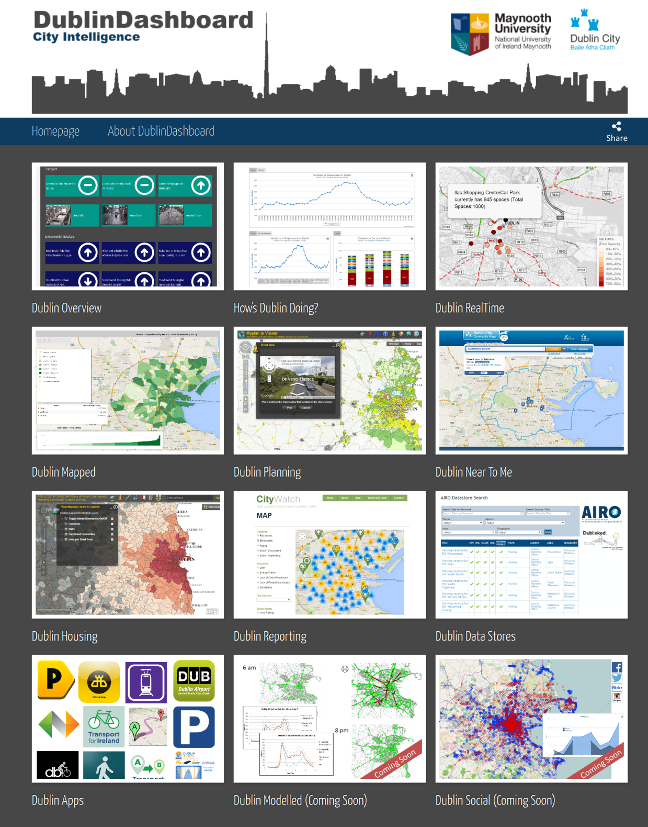
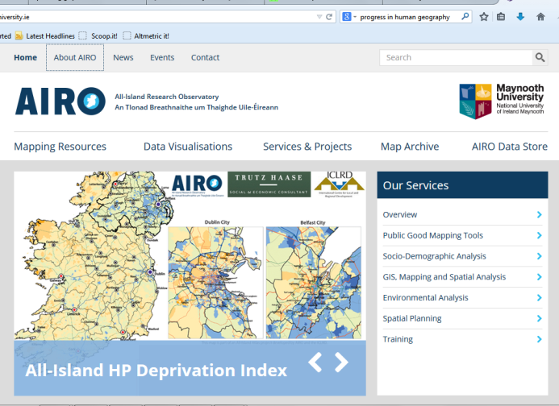
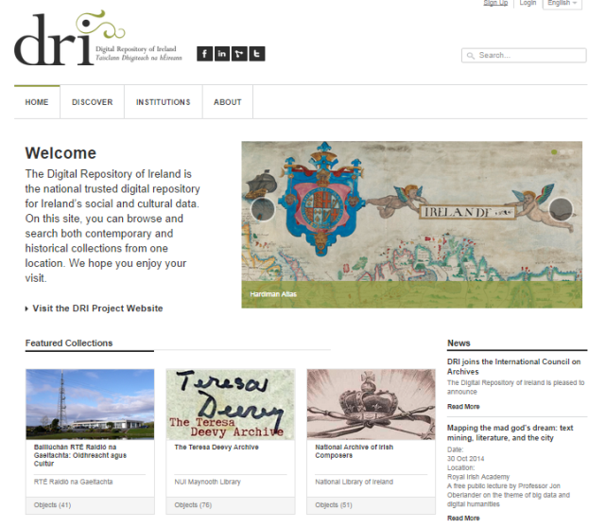
Background
All-Island Research Observatory (www.airo.ie)
Dublin Dashboard (www.dublindashboard.ie)
Digital Repository of Ireland (DRI; www.dri.ie)
The Programmable City

Slide 3
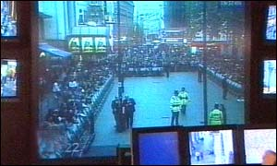
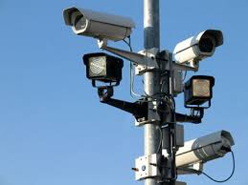
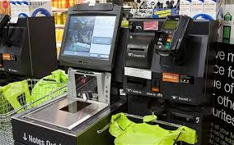
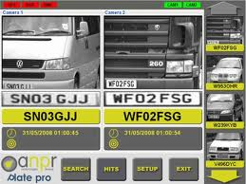
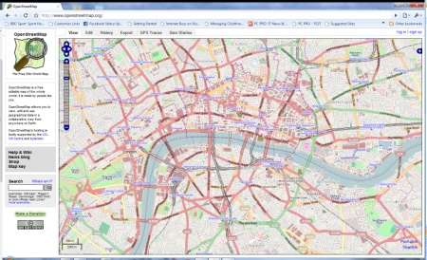
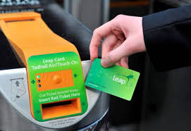
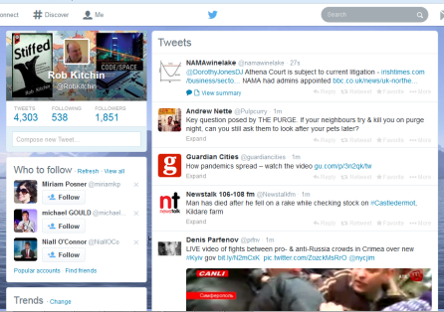
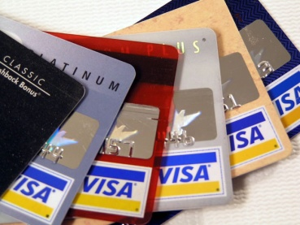
Big data & smart cities
Diverse range of public and private generation of fine-scale (uniquely indexical) data about citizens and places in real-time:
utilities
transport providers
environmental agencies
mobile phone operators
travel and accommodation websites
social media sites
financial institutions and retail chains
private surveillance and security firms
emergency services
home appliances and entertainment systems
Producing a data deluge that can be combined, analyzed, acted upon

Slide 4
Data type | Data collected by Uber android app (from Hein 2014)
Accounts log | email log
App Activity | name, package name, process number of activity, processed id
App Data Usage | Cache size, code size, data size, name, package name
App Install | installed at, name, package name, unknown sources enabled, version code, version name
Battery | health, level, plugged, present, scale, status, technology, temperature, voltage
Device Info | board, brand, build version, cell number, device, device type, display, fingerprint, IP, MAC address, manufacturer, model, OS platform, product, SDK code, total disk space, unknown sources enabled
GPS | accuracy, altitude, latitude, longitude, provider, speed
MMS | from number, MMS at, MMS type, service number, to number
NetData | bytes received, bytes sent, connection type, interface type
PhoneCall | call duration, called at, from number, phone call type, to number
SMS | from number, service number, SMS at, SMS type, to number
TelephonyInfo | cell tower ID, cell tower latitude, cell tower longitude, IMEI, ISO country code, local area code, MEID, mobile country code, mobile network code, network name, network type, phone type, SIM serial number, SIM state, subscriber ID
WifiConnection | BSSID, IP, linkspeed, MAC addr, network ID, RSSI, SSID
WifiNeighbors | BSSID, capabilities, frequency, level, SSID
Root Check | root status code, root status reason code, root version, sig file version
Malware Info | algorithm confidence, app list, found malware, malware SDK version, package list, reason code, service list, sigfile version

Slide 5
Ethics and politics of data
Consists of much more than issues of privacy and security that it often gets boiled down to:
Data ownership and control
Data integration and data markets
Data security and integrity
Data protection and privacy
Data quality and provenance
Dataveillance/surveillance
Data uses: Social sorting, predictive profiling, control creep, dynamic pricing, anticipatory governance
The politics of data
Each of these issues is: multidimensional & contested; involve multiple ethical & political questions; varies in nature across domains; which ethical philosophy adopted matters

Slide 6
A Taxonomy of Privacy (compiled from Solove 2006)
Domain | Privacy breach | Description
Information Collection | Surveillance | Watching, listening to, or recording of an individual’s activities
 | Interrogation | Various forms of questioning or probing for information
Information Processing | Aggregation | The combination of various pieces of data about a person
 | Identification | Linking information to particular individuals
 | Insecurity | Carelessness in protecting stored information from leaks and improper access
 | Secondary Use | Use of information collected for one purpose for a different purpose without the data subject’s consent
 | Exclusion | Failure to allow the data subject to know about the data that others have about her and participate in its handling and use, including being barred from being able to access and correct errors
Information Dissemination | Breach of Confidentiality | Breaking a promise to keep a person’s information confidential
 | Disclosure | Revelation of information about a person that impacts the way others judge her character
 | Exposure | Revealing another’s nudity, grief, or bodily functions
 | Increased Accessibility | Amplifying the accessibility of information
 | Blackmail | Threat to disclose personal information
 | Appropriation | The use of the data subject’s identity to serve the aims and interests of another
 | Distortion | Dissemination of false or misleading information about individuals
Invasion | Intrusion | Invasive acts that disturb one’s tranquillity or solitude
 | Decisional Interference | Incursion into the data subject’s decisions regarding her private affairs

Slide 7
The politics of urban data
Digital socio-technical assemblage
System/process
performs a task
Context
frames the system/task
Reception/Operation (user/usage)
Systems of thought
Forms of knowledge
Interface
Practices
Code/algorithms
(software)
Finance
Political economies
Data(base)
Governmentalities & legalities
Organisations and institutions
Code Platform
(operating system)
Subjectivities and communities
Material Platform
(infrastructure – hardware)
Marketplace
Places

Slide 8
Philosophy, ethics and data
Egalitarianism -- equality in power/rights regardless of ability and inheritance
Utilitarianism -- the greater good for the greatest number
Libertarianism -- prioritises the value of the individual over the state and society; free-market is inherently just
Contractarianism -- seeks to find a position that all involved considers just (not equal)
Communitarianism –- promotes ideas of community, and community ways of life with common shared practices and shared understandings
Each ethics philosophy leads to a particular kind of Magna Carta

Slide 9
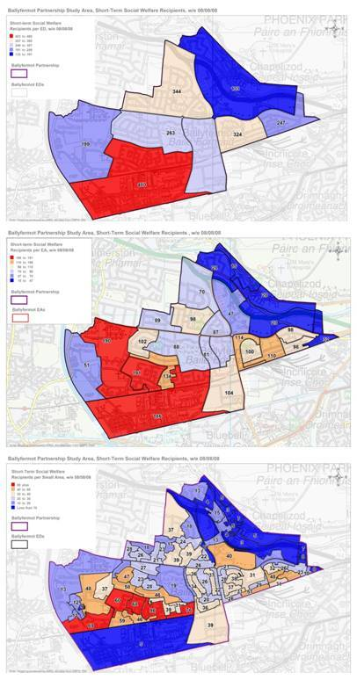
Technical data concerns and ethics
Data coverage and access (openness)
Data quality and provenance: veracity (accuracy, fidelity), uncertainty, error, bias, reliability, calibration, lineage
Quality, veracity and transparency of data analytics
Ecological fallacy and interpretation issues
Downstream consequences of data uses on poor quality data

Slide 10
Magna Carta for Data
Bill of rights concerning data
Set of general principles – voluntary code?
Refresh and extension of Fair Information Practice Principles?

Slide 11
Fair Information Practice Principles
Principle | Description
Notice | Individuals are informed that data are being generated and the purpose to which the data will be put
Choice | Individuals have the choice to opt-in or opt-out as to whether and how their data will be used or disclosed
Consent | Data are only generated and disclosed with the consent of individuals
Security | Data are protected from loss, misuse, unauthorized access, disclosure, alteration and destruction
Integrity | Data are reliable, accurate, complete and current
Access | Individuals can access, check and verify data about themselves
Accountability | The data holder is accountable for ensuring the above principles and has mechanisms in place to assure compliance

Slide 12
Magna Carta for Data
Bill of rights concerning data
Set of general principles – voluntary code?
Refresh and extension of Fair Information Practice Principles?
High level rather than nitty-gritty rules and practices within domains
Is not going to mitigate the need for standards, protocols, regulation and legislation; but could help guide/frame debates
Would be one part of every data assemblage
Designing a Magna Carta for Data will be an exercise in negotiating the politics of data and philosophy/ethics
Certainly a worthwhile exercise, but will not be a panacea to evolving big data ethical issues

Slide 13
Rob.Kitchin@nuim.ie
@robkitchin
www.maynoothuniversity.ie/progcity

Slide 14
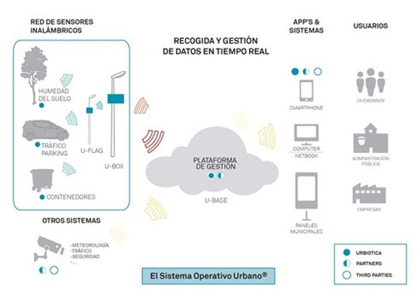
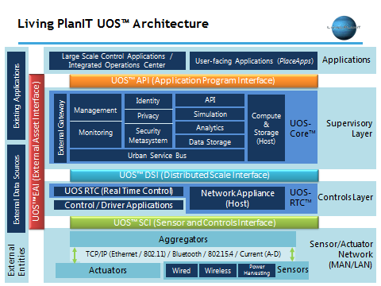
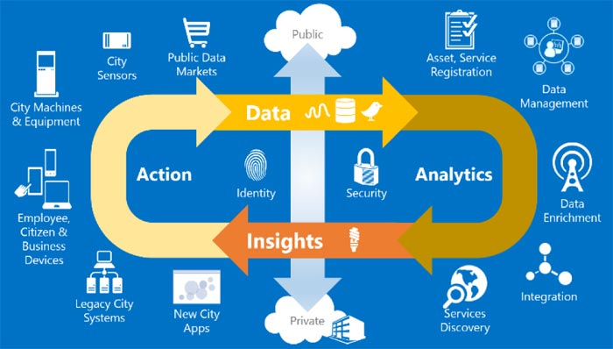
Integrated, city & sector wide

Slide 15
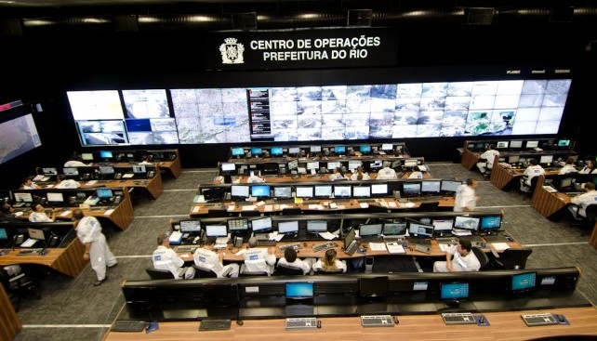
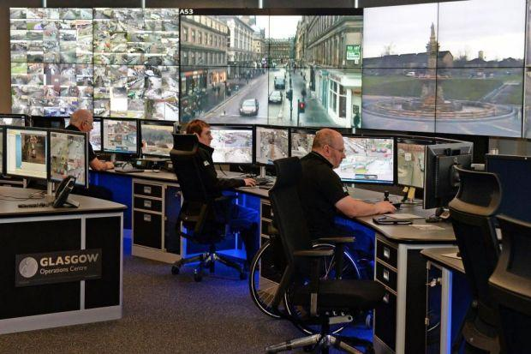
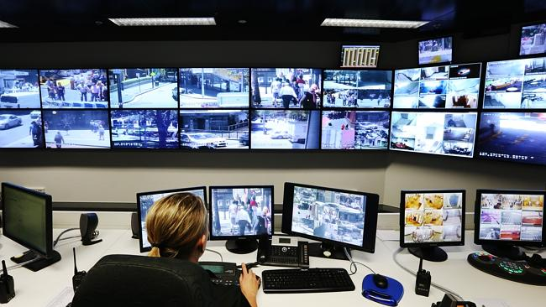
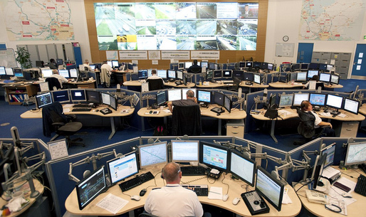
Data-driven, networked urbanism

